Slide 1
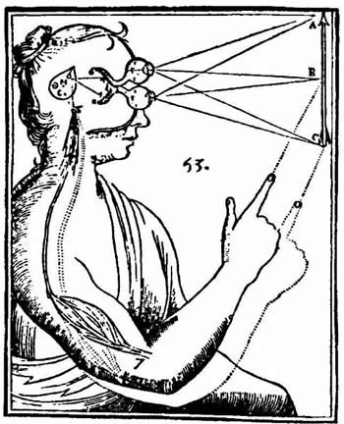
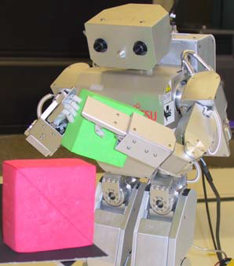
Introduction to Computer Vision
Fei He
Visiting Scholar
University of Missouri
Northeast Normal University
hefe@Missouri.edu

Slide 2
What’s on our plate today?
Goals of the course
What is computer vision?
Applications
Intro to Image
Image interpolation
Domain transformations
Affine image transformations
Range (intensity) transformations
Noise reduction through spatial filtering
Filtering as cross-correlation
Convolution
Nonlinear (median) filtering

Slide 3
Goals of the course
Provide an introduction to computer vision
Set up the foundation for understanding deep learning (especially CNN)
Set up the foundation for understanding advanced visual deep learning models

Slide 4
What’s on our plate today?
Goals of the course
What is computer vision?
Applications
Intro to Image
Image interpolation
Domain transformations
Affine image transformations
Range (intensity) transformations
Noise reduction through spatial filtering
Filtering as cross-correlation
Convolution
Nonlinear (median) filtering

Slide 5
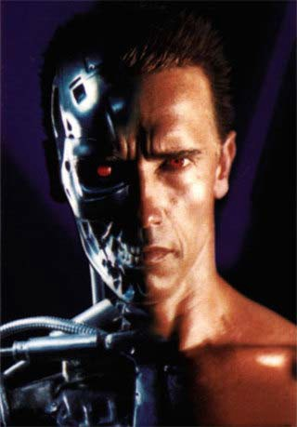
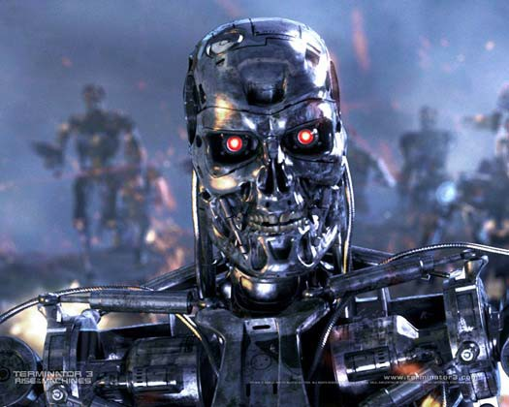
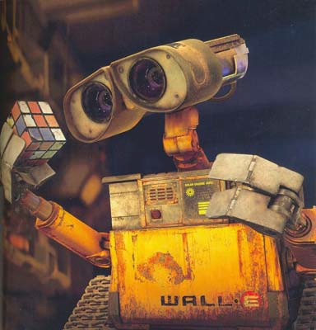
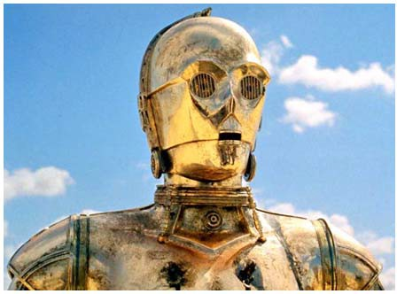
What is computer vision?
Computer vision according to Hollywood

Slide 6
What is computer vision?
Making useful decisions about real physical objects and scenes based on images (Shapiro & Stockman, 2001)
Extracting descriptions of the world from pictures or sequences of pictures (Forsyth & Ponce, 2003)
Analyzing images and producing descriptions that can be used to interact with the environment (Horn, 1986)
Designing representations and algorithms for relating images to models of the world (Ballard & Brown, 1982)

Slide 7
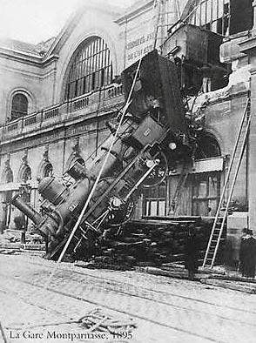
A picture is worth a thousand words
Can a computer infer what happened from the image?

Slide 8
What’s on our plate today?
Goals of the course
What is computer vision?
Applications
Intro to Image
Image interpolation
Domain transformations
Affine image transformations
Range (intensity) transformations
Noise reduction through spatial filtering
Filtering as cross-correlation
Convolution
Nonlinear (median) filtering

Slide 9
Computer Vision: Current State of the Art
The next few slides show examples of what current computer vision systems can do…

Slide 10
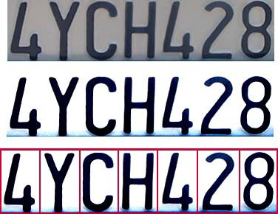

Optical character recognition (OCR)
Technology to convert scanned docs to text
If you have a scanner, it probably came with OCR software
Digit recognition, AT&T labs http://www.research.att.com/~yann/
License plate readers
http://en.wikipedia.org/wiki/Automatic_number_plate_recognition

Slide 11
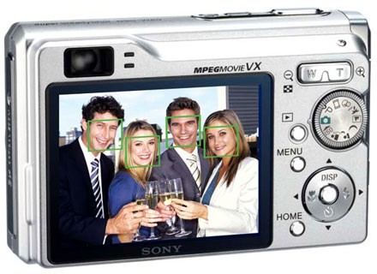
Face Detection
Most new digital cameras now detect faces

Slide 12
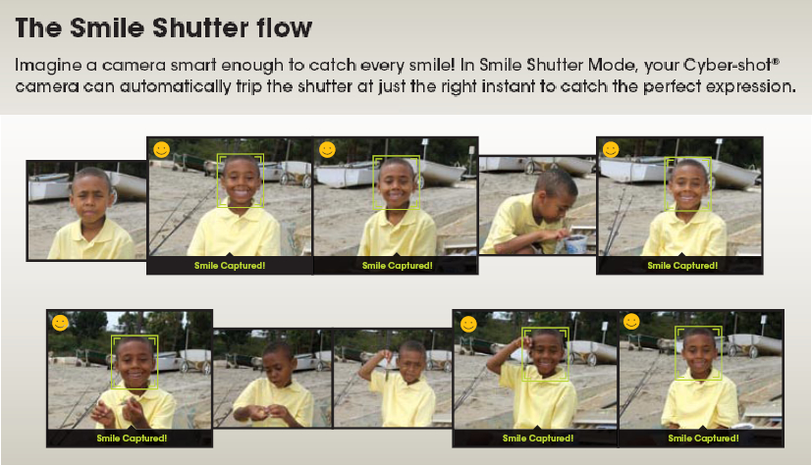
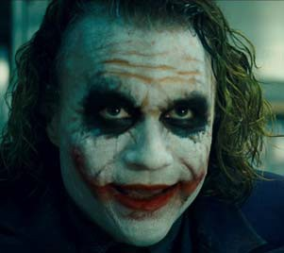
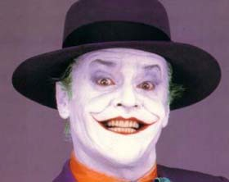
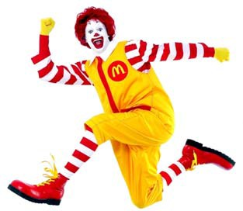
Smile Detection (automatically clicks when you smile!)
Sony Cyber-shot® T70 Digital Still Camera
Some unhappy customers

Slide 13
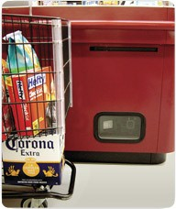

Object Recognition (in supermarkets)
Camera
LaneHawk by EvolutionRobotics
“A smart camera is flush-mounted in the checkout lane, continuously watching for items. When an item is detected and recognized, the cashier verifies the quantity of items that were found under the basket, and continues to close the transaction. The item can remain under the basket, and with LaneHawk, you are assured to get paid for it…”

Slide 14
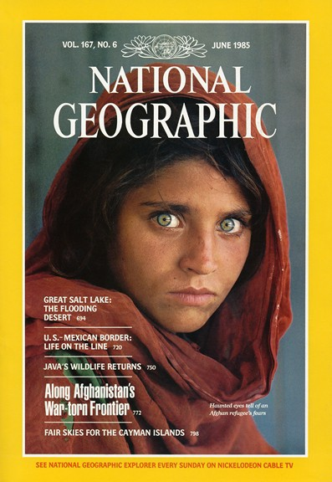
Vision-Based Biometrics
Sharbat Gula at age 12 in an Afghan refugee camp in 1984
Traced in 2002 but is she the same person?

Slide 15
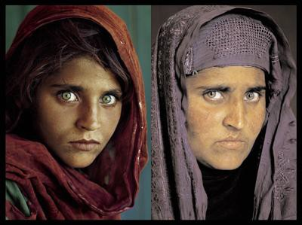
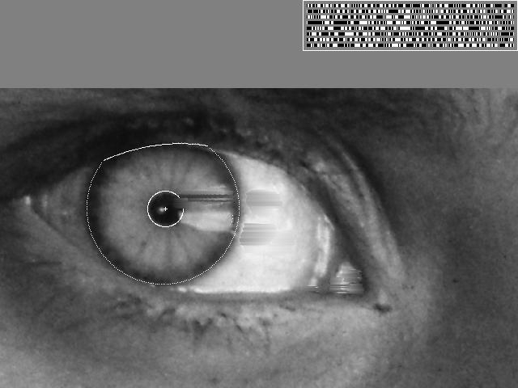
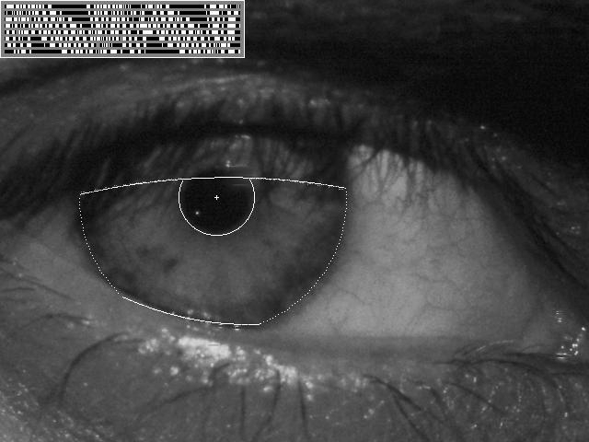
Identity verification through Iris code
1984
2002
“How the Afghan Girl was Identified by Her Iris Patterns” Read the story

Slide 16
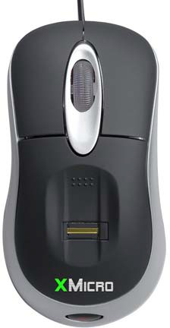
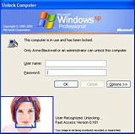

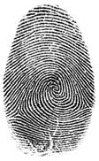
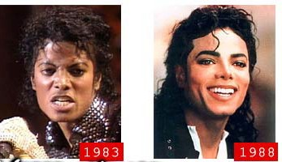
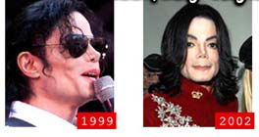
Login with your fingerprint or face
Face identification systems now beginning to appear more widely http://www.sensiblevision.com
http://www.xmicro.com
Could be a problem if your face changes often

Slide 17
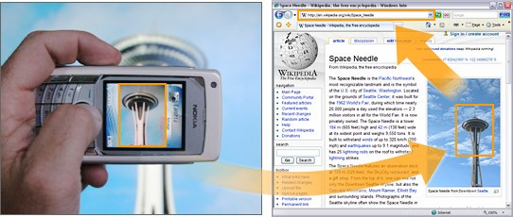
Object recognition (in mobile phones)
This is becoming real:
Lincoln Microsoft Research: Mobile web search via pictures
Nokia’s Point & Find

Slide 18
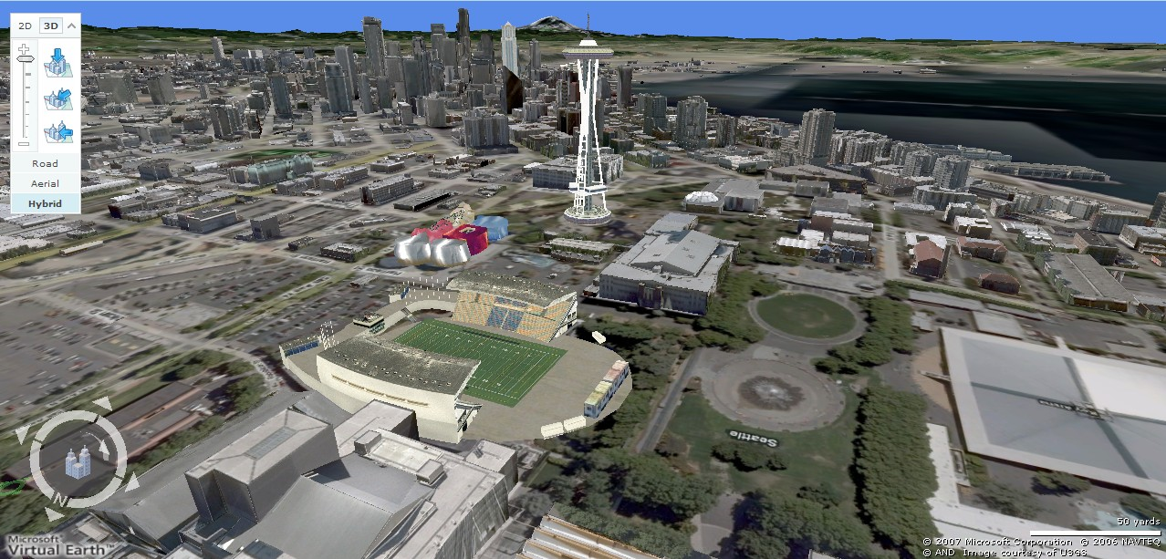
3D modeling: Earth viewers
Image from Microsoft’s Virtual Earth (see also: Google Earth)

Slide 19
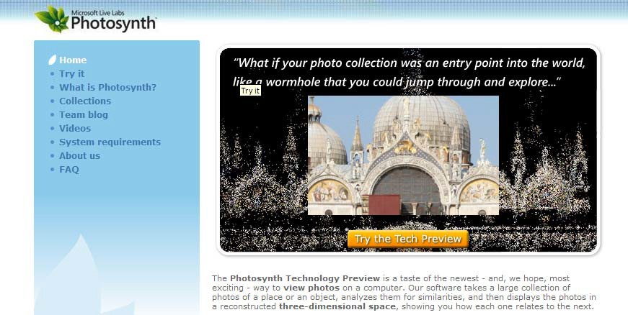
Photosynth
http://photosynth.net
Based on Photo Tourism technology developed here in CSE! by Noah Snavely, Steve Seitz, and Rick Szeliski

Slide 20
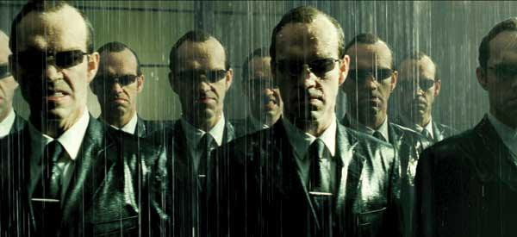
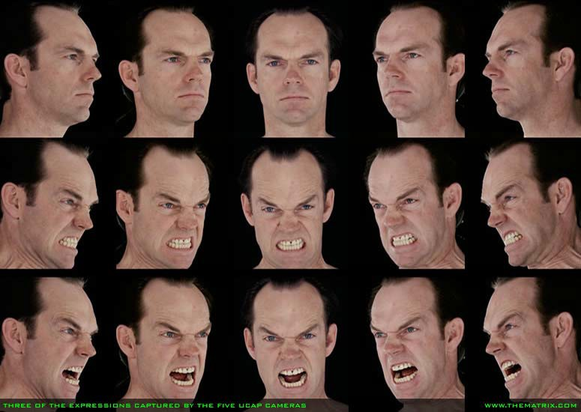
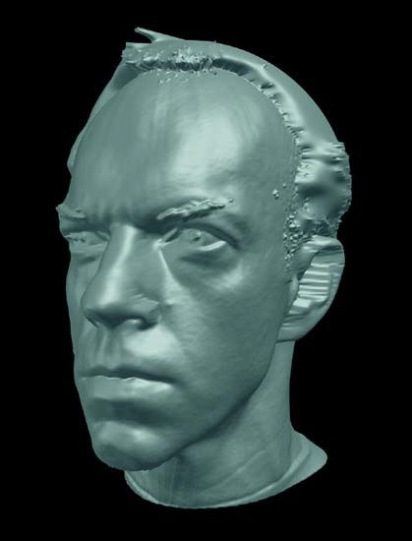
Special effects: shape capture
The Burly Brawl scene in The Matrix Reloaded

Slide 21
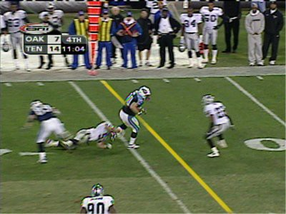
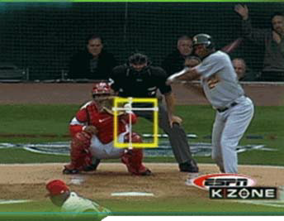
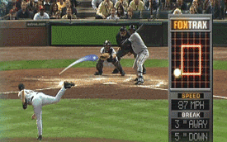
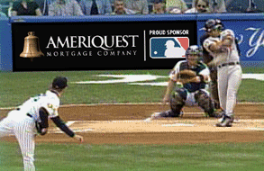
Sports (http://www.sportvision.com)
Virtual first down line
(explanation on www.howstuffworks.com)
Real-time strike zone box
Ball tracking
Virtual Ads!

Slide 22
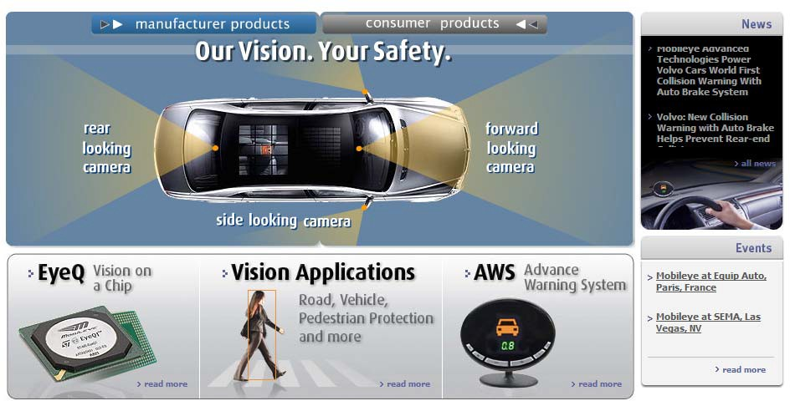
Smart cars
Slide content courtesy of Amnon Shashua
Mobileye
Vision systems currently in high-end BMW, GM, Volvo models
70% of car manufacturers

Slide 23
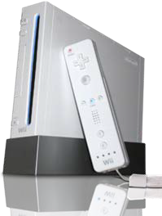
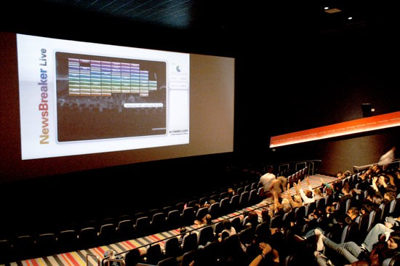
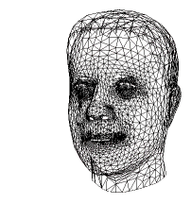
Vision-based interaction and games
“Game turns moviegoers into Human Joysticks”, CNET Camera tracking a crowd, based on this work.
Nintendo Wii has camera-based IR tracking built in. See Lee’s work at CMU on clever tricks on using it to create a multi-touch display!
Digimask: put your face on a 3D avatar

Slide 24
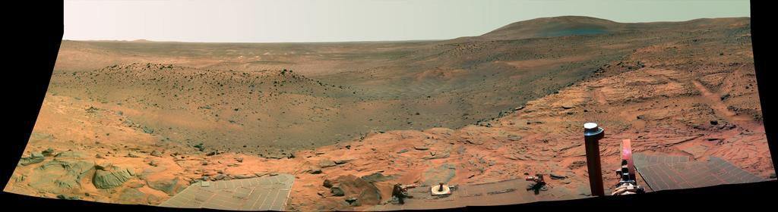
Computer vision in space
NASA'S Mars Exploration Rover Spirit captured this westward view from atop a low plateau where Spirit spent the closing months of 2007.
Vision systems (JPL) used for several tasks
Panorama stitching
3D terrain modeling
Obstacle detection, position tracking
For more, read “Computer Vision on Mars” by Matthies et al.

Slide 25
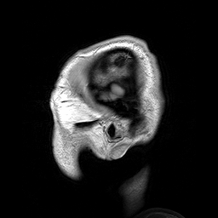
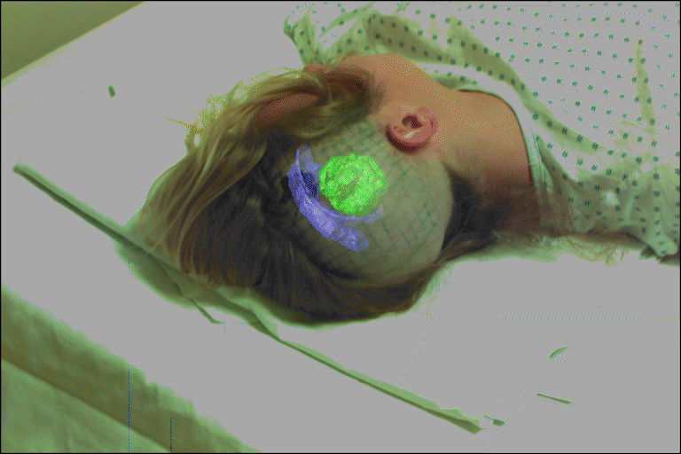
Medical imaging
Image guided surgery
Grimson et al., MIT
3D imaging MRI

Slide 26
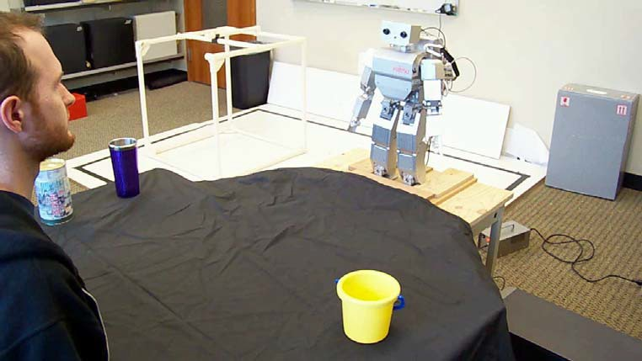
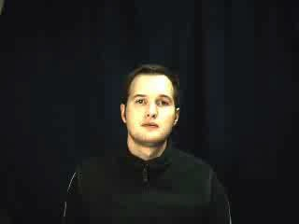
Vision-Based Robotic Learning of Language
Robot learns names for new objects through gaze following
Research done by UW CSE student Aaron Shon

Slide 27
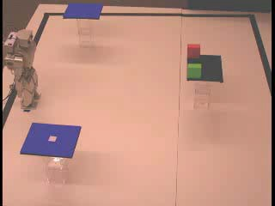
Vision-Guided Brain-Robot Interfaces
CBS News Article

Slide 28
Current state of the art
You just saw examples of current systems.
Many of these are less than 5 years old
This is a very active research area, and rapidly changing
Many new apps in the next 5 years
1st Question:
What is an image?

Slide 29
What’s on our plate today?
Goals of the course
What is computer vision?
Applications
Intro to Image
Image interpolation
Domain transformations
Affine image transformations
Range (intensity) transformations
Noise reduction through spatial filtering
Filtering as cross-correlation
Convolution
Nonlinear (median) filtering

Slide 30
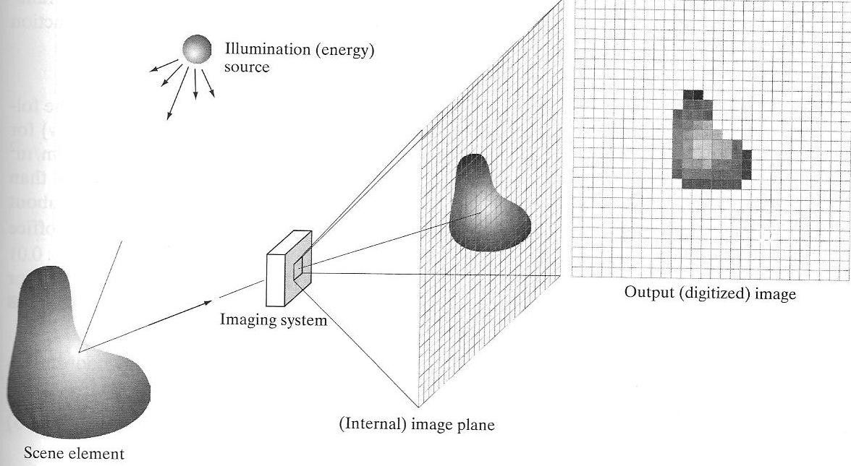
Image Formation: Basics
i(x,y)
f(x,y)
r(x,y)
(from Gonzalez & Woods, 2008)

Slide 31
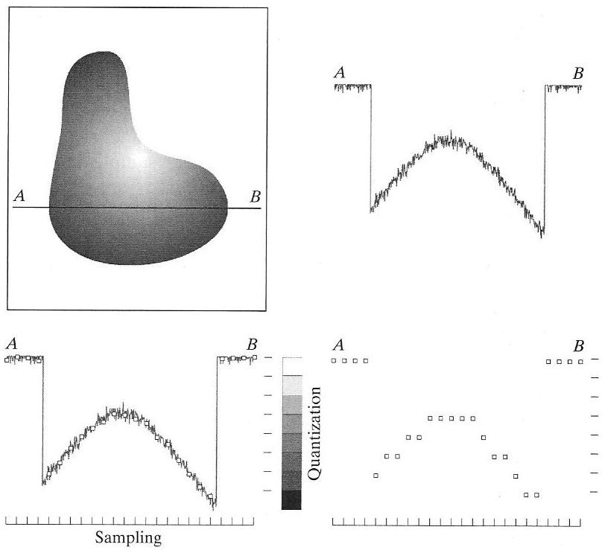
Sampling and Quantization Process
(from Gonzalez & Woods, 2008)

Slide 32
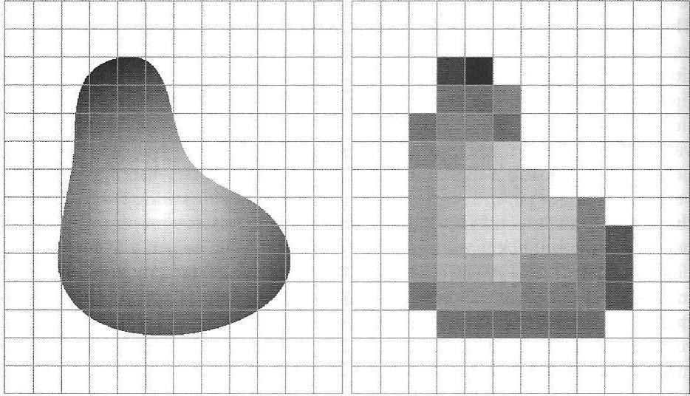
Example of a Quantized 2D Image
Continuous image projected onto sensor array
Result of sampling and quantization
(from Gonzalez & Woods, 2008)

Slide 33
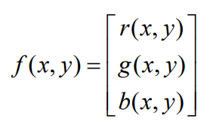
What is an image?
Think of an image as a function, f, from R² to R:
f( x, y ) gives the intensity at position ( x, y )
Realistically, images defined over a rectangle:
f: [a,b]x[c,d] → [0,1]
Color image = three functions pasted together

Slide 34
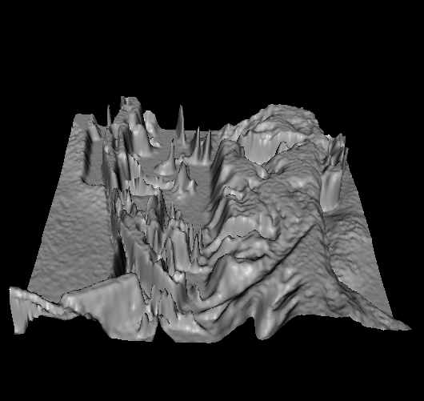
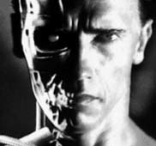
An image as a function
f(x,y)
y
x
Bright regions are high, dark regions are low

Slide 35
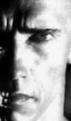
Digital images
In computer vision we usually operate on
digital (discrete) images:
Sample the 2D space on a regular grid
Quantize each sample (round to nearest integer)
Each sample is a “pixel” (picture element)
If 1 byte for each pixel, values range from 0 to 255
y
x
62 | 79 | 23 | 119 | 120 | 105 | 4 | 0
10 | 10 | 9 | 62 | 12 | 78 | 34 | 0
10 | 58 | 197 | 46 | 46 | 0 | 0 | 48
176 | 135 | 5 | 188 | 191 | 68 | 0 | 49
2 | 1 | 1 | 29 | 26 | 37 | 0 | 77
0 | 89 | 144 | 147 | 187 | 102 | 62 | 208
255 | 252 | 0 | 166 | 123 | 62 | 0 | 31
166 | 63 | 127 | 17 | 1 | 0 | 99 | 30
Example: plot_camera_numpy.ipynb

Slide 36


Image processing
An image processing operation converts an existing image f to a new image g
Noise filtering

Slide 37


Image Processing
Translation
Rotation

Slide 38
What’s on our plate today?
Goals of the course
What is computer vision?
Applications
Intro to Image
Image interpolation
Domain transformations
Affine image transformations
Range (intensity) transformations
Noise reduction through spatial filtering
Filtering as cross-correlation
Convolution
Nonlinear (median) filtering

Slide 39

Suppose we want to zoom an image
Need to fill in values for new pixels
Original image
Zoomed image

Slide 40
Interpolation
Original
Zoomed
**** **** **** **** **** ****
Need to fill in missing values *
Nearest Neighbor Interpolation
For each new pixel, copy nearest value

Slide 41


Neared Neighbor Interpolation
Can we do better?
Original image
Zoomed image

Slide 42


Other image interpolation techniques
Bilinear interpolation:
Compute pixel value v(x,y) as:
v(x, y) = ax + by + cxy + d
a, b, c, d determined from four nearest neighbors of (x,y)
Bicubic interpolation:
(Used in most commercial image editing programs, e.g., Photoshop)
3 3
v(x, y) =
∑∑ ij
i j
a x y
i=0 j =0
a_{ij} determined from 16 nearest
neighbors of (x,y)
(from http://www.cambridgeincolour.com/tutorials/image-interpolation.htm)
See also http://en.wikipedia.org/wiki/Bilinear_interpolation

Slide 43

Comparison of Interpolation Techniques
Nearest Neighbor
Bilinear
Bicubic
Note: Neighbors are important!

Slide 44
What’s on our plate today?
Goals of the course
What is computer vision?
Applications
Intro to Image
Image interpolation
Domain transformations
Affine image transformations
Range (intensity) transformations
Noise reduction through spatial filtering
Filtering as cross-correlation
Convolution
Nonlinear (median) filtering

Slide 45
Recall from Last Time
Translation
Rotation
How are these done?

Slide 46
Geometric spatial transformations of images
Two steps:
Spatial transformation of coordinates (x,y)
Interpolation of intensity value at new coordinates
We already know how to do (2), so focus on (1)
Example: What does the transformation (x,y) = T((v,w)) = (v/2,w/2) do?
[Shrinks original image in half in both directions]

Slide 47



Affine Transformations
Transformation Affine Matrix T Coordinate Equations
Example

Slide 48

Affine Transformations (cont.)
Transformation Affine Matrix T Coordinate Equations
Example
Such transformation matrices also called Kernel

Slide 49

Example of Affine Transformation
Image rotated 21 degrees
Nearest Neighbor
Bilinear
Bicubic
Example: plot_geometric.ipynb
(from Gonzalez & Woods, 2008)

Slide 50
What’s on our plate today?
Goals of the course
What is computer vision?
Applications
Intro to Image
Image interpolation
Domain transformations
Affine image transformations
Range (intensity) transformations
Noise reduction through spatial filtering
Filtering as cross-correlation
Convolution
Nonlinear (median) filtering

Slide 51
Recall from last time
Noise filtering
How is this done?

Slide 52



Image processing for noise reduction
Common types of noise:
Salt and pepper noise: contains random occurrences of black and white pixels
Impulse noise: contains random occurrences of white pixels
Gaussian noise: variations in intensity drawn from a Gaussian normal distribution
Original
Salt and pepper noise
Impulse noise
Gaussian noise

Slide 53


How do we reduce the effects of noise?
0 | 0 | 0 | 0 | 0 | 0 | 0 | 0 | 0 | 0
0 | 0 | 0 | 0 | 0 | 0 | 0 | 0 | 0 | 0
0 | 0 | 0 | 90 | 90 | 90 | 90 | 90 | 0 | 0
0 | 0 | 0 | 90 | 90 | 90 | 90 | 90 | 0 | 0
0 | 0 | 0 | 90 | 90 | 90 | 90 | 90 | 0 | 0
0 | 0 | 0 | 90 | 0 | 90 | 90 | 90 | 0 | 0
0 | 0 | 0 | 90 | 90 | 90 | 90 | 90 | 0 | 0
0 | 0 | 0 | 0 | 0 | 0 | 0 | 0 | 0 | 0
0 | 0 | 90 | 0 | 0 | 0 | 0 | 0 | 0 | 0
0 | 0 | 0 | 0 | 0 | 0 | 0 | 0 | 0 | 0

Slide 54
How do we reduce the effects of noise?
0 | 0 | 0 | 0 | 0 | 0 | 0 | 0 | 0 | 0
0 | 0 | 0 | 0 | 0 | 0 | 0 | 0 | 0 | 0
0 | 0 | 0 | 90 | 90 | 90 | 90 | 90 | 0 | 0
0 | 0 | 0 | 90 | 90 | 90 | 90 | 90 | 0 | 0
0 | 0 | 0 | 90 | 90 | 90 | 90 | 90 | 0 | 0
0 | 0 | 0 | 90 | 0 | 90 | 90 | 90 | 0 | 0
0 | 0 | 0 | 90 | 90 | 90 | 90 | 90 | 0 | 0
0 | 0 | 0 | 0 | 0 | 0 | 0 | 0 | 0 | 0
0 | 0 | 90 | 0 | 0 | 0 | 0 | 0 | 0 | 0
0 | 0 | 0 | 0 | 0 | 0 | 0 | 0 | 0 | 0
 |  |  |  | 80

Slide 55
How do we reduce the effects of noise?
0 | 0 | 0 | 0 | 0 | 0 | 0 | 0 | 0 | 0
0 | 0 | 0 | 0 | 0 | 0 | 0 | 0 | 0 | 0
0 | 0 | 0 | 90 | 90 | 90 | 90 | 90 | 0 | 0
0 | 0 | 0 | 90 | 90 | 90 | 90 | 90 | 0 | 0
0 | 0 | 0 | 90 | 90 | 90 | 90 | 90 | 0 | 0
0 | 0 | 0 | 90 | 0 | 90 | 90 | 90 | 0 | 0
0 | 0 | 0 | 90 | 90 | 90 | 90 | 90 | 0 | 0
0 | 0 | 0 | 0 | 0 | 0 | 0 | 0 | 0 | 0
0 | 0 | 90 | 0 | 0 | 0 | 0 | 0 | 0 | 0
0 | 0 | 0 | 0 | 0 | 0 | 0 | 0 | 0 | 0
 |  |  |  | 80
 |  | 10
Idea: Compute mean value for each pixel from neighbors

Slide 56
Mean filtering
0 | 0 | 0 | 0 | 0 | 0 | 0 | 0 | 0 | 0
0 | 0 | 0 | 0 | 0 | 0 | 0 | 0 | 0 | 0
0 | 0 | 0 | 90 | 90 | 90 | 90 | 90 | 0 | 0
0 | 0 | 0 | 90 | 90 | 90 | 90 | 90 | 0 | 0
0 | 0 | 0 | 90 | 90 | 90 | 90 | 90 | 0 | 0
0 | 0 | 0 | 90 | 0 | 90 | 90 | 90 | 0 | 0
0 | 0 | 0 | 90 | 90 | 90 | 90 | 90 | 0 | 0
0 | 0 | 0 | 0 | 0 | 0 | 0 | 0 | 0 | 0
0 | 0 | 90 | 0 | 0 | 0 | 0 | 0 | 0 | 0
0 | 0 | 0 | 0 | 0 | 0 | 0 | 0 | 0 | 0
 | 0 | 10 | 20 | 30 | 30 | 30 | 20 | 10
 | 0 | 20 | 40 | 60 | 60 | 60 | 40 | 20
 | 0 | 30 | 60 | 90 | 90 | 90 | 60 | 30
 | 0 | 30 | 50 | 80 | 80 | 90 | 60 | 30
 | 0 | 30 | 50 | 80 | 80 | 90 | 60 | 30
 | 0 | 20 | 30 | 50 | 50 | 60 | 40 | 20
 | 10 | 20 | 30 | 30 | 30 | 30 | 20 | 10
 | 10 | 10 | 10 | 0 | 0 | 0 | 0 | 0

Slide 57


Filtering as cross-correlation
Can generalize this by allowing different weights for different neighboring pixels:
This is called cross-correlation, denoted by:
H is called the “filter,” “kernel,” or “mask.”
Note: During implementation, we avoid the negative filter indices by using H[u+k,v+k] instead of H[u,v]

Slide 58

Kernel for mean filtering
What is the kernel for a 3x3 mean filter?
0 | 0 | 0 | 0 | 0 | 0 | 0 | 0 | 0 | 0
0 | 0 | 0 | 0 | 0 | 0 | 0 | 0 | 0 | 0
0 | 0 | 0 | 90 | 90 | 90 | 90 | 90 | 0 | 0
0 | 0 | 0 | 90 | 90 | 90 | 90 | 90 | 0 | 0
0 | 0 | 0 | 90 | 90 | 90 | 90 | 90 | 0 | 0
0 | 0 | 0 | 90 | 0 | 90 | 90 | 90 | 0 | 0
0 | 0 | 0 | 90 | 90 | 90 | 90 | 90 | 0 | 0
0 | 0 | 0 | 0 | 0 | 0 | 0 | 0 | 0 | 0
0 | 0 | 90 | 0 | 0 | 0 | 0 | 0 | 0 | 0
0 | 0 | 0 | 0 | 0 | 0 | 0 | 0 | 0 | 0

Slide 59
Kernel for mean filtering
What is the kernel for a 3x3 mean filter?
0 | 0 | 0 | 0 | 0 | 0 | 0 | 0 | 0 | 0
0 | 0 | 0 | 0 | 0 | 0 | 0 | 0 | 0 | 0
0 | 0 | 0 | 90 | 90 | 90 | 90 | 90 | 0 | 0
0 | 0 | 0 | 90 | 90 | 90 | 90 | 90 | 0 | 0
0 | 0 | 0 | 90 | 90 | 90 | 90 | 90 | 0 | 0
0 | 0 | 0 | 90 | 0 | 90 | 90 | 90 | 0 | 0
0 | 0 | 0 | 90 | 90 | 90 | 90 | 90 | 0 | 0
0 | 0 | 0 | 0 | 0 | 0 | 0 | 0 | 0 | 0
0 | 0 | 90 | 0 | 0 | 0 | 0 | 0 | 0 | 0
0 | 0 | 0 | 0 | 0 | 0 | 0 | 0 | 0 | 0
1 | 1 | 1
1 | 1 | 1
1 | 1 | 1
1/9

Slide 60



Example of mean filtering
Input image
Filtered Images
Salt and pepper noise
3 x 3
5 x 5 Kernel size
7 x 7
Example: plot_rank_mean.ipynb

Slide 61



Gaussian Filtering
A Gaussian kernel gives less weight to pixels further from the center of the window
1 | 2 | 1
2 | 4 | 2
1 | 2 | 1
0 | 0 | 0 | 0 | 0 | 0 | 0 | 0 | 0 | 0
0 | 0 | 0 | 0 | 0 | 0 | 0 | 0 | 0 | 0
0 | 0 | 0 | 90 | 90 | 90 | 90 | 90 | 0 | 0
0 | 0 | 0 | 90 | 90 | 90 | 90 | 90 | 0 | 0
0 | 0 | 0 | 90 | 90 | 90 | 90 | 90 | 0 | 0
0 | 0 | 0 | 90 | 0 | 90 | 90 | 90 | 0 | 0
0 | 0 | 0 | 90 | 90 | 90 | 90 | 90 | 0 | 0
0 | 0 | 0 | 0 | 0 | 0 | 0 | 0 | 0 | 0
0 | 0 | 90 | 0 | 0 | 0 | 0 | 0 | 0 | 0
0 | 0 | 0 | 0 | 0 | 0 | 0 | 0 | 0 | 0
Kernel approximates Gaussian function:
What happens if you increase σ ?

Slide 62

Mean versus Gaussian filtering
Input Image
Mean filtered
Gaussian filtered

Slide 63


Convolution
A convolution is a cross-correlation where the filter is flipped both horizontally and vertically before being applied to the image:
Written as:
Compare with cross-correlation:
If H is a Gaussian or mean kernel, how does convolution differ from cross-correlation?

Slide 64
Why convolution?
Convolution is associative (cross-corr. is not): F * (G * I) = (F * G) * I
Important for efficiency:
To apply two filters F and G sequentially to incoming images I, pre-compute (F * G) and perform only 1 convolution (with pre- computed filter)
Convolution also allows effects of filtering to be analyzed using Fourier analysis (will touch on this later)

Slide 65
Cross-correlation and template matching
Cross-correlation is useful for template matching
(locating a given pattern in an image)
Image
Template (pattern)
 | a | b | c
 | d | e | f
 | g | h | i
a | b | c
d | e | f
g | h | i
Highest value yields location of pattern in image

Slide 66
Nonlinear filters: Median filter
A Median Filter replaces the value of a pixel by the median of intensity values of neighbors
Recall: m is the median of a set of values iff half the values in the set are <= m and half are >= m.
Median filtering of image I: For each location (x,y), sort intensity values in its neighborhood, determine median intensity value, and assign that value to I(x,y)
Is a median filter better than a mean filter?
Is median filtering a convolution?

Slide 67


Comparison of filters (salt-and-pepper noise)

Slide 68


Comparison of filters (Gaussian noise)

Slide 69
What’s on our plate today?
Image sampling and pyramid
Edge detection

Slide 70

Motivation
This image is too big to fit on the screen.
How can we shrink it to half its size?

Slide 71



Image sub-sampling
Throw away every other row and column to create a smaller image
- called image sub-sampling
1/8
1/4
1/2

Slide 72


Image sub-sampling
1/2
1/4 1/8
(2x zoom)
(4x zoom)
Waarom zo jagged kijk ik?*
*Dutch for “Why do I look so jagged?”

Slide 73


Artifacts arising from bad sampling
Jagged profiles
represents a sampled location
Missing details

Slide 74

2D example
Good sampling
Bad sampling

Slide 75



Sub-sampling with Gaussian pre-filtering
Blur the image (low pass filter) the image, then subsample
Blur using Gaussian filter
Filter size should double for each ½ size reduction (Nyquist)
G 1/8
G 1/4
Gaussian 1/2

Slide 76


Sub-sampling with Gaussian pre-filtering
Gaussian 1/2
G 1/4 (2xzoom)
G 1/8 (4xzoom)

Slide 77

Compare with...
1/2
1/4 (2x zoom)
1/8 (4x zoom)

Slide 78

Some times we want many resolutions
Known as a Gaussian Pyramid [Burt and Adelson, 1983]
In computer graphics, a mip map [Williams, 1983]
A precursor to wavelet transform
Gaussian Pyramids have all sorts of applications in computer vision
Texture synthesis, compression, feature detection, object recognition

Slide 79
Gaussian pyramid construction
filter kernel
Repeat
Filter w/ Gaussian
Subsample
Until minimum resolution reached
can specify desired number of levels (e.g., 3-level pyramid)
The whole pyramid is only 4/3 the size of the original image!

Slide 80


Image resampling
So far, we considered only power-of-two subsampling
What about arbitrary scale reduction?
How can we increase the size of the image?
d = 1 in this example
1 2 3 4
Recall how a digital image is formed
5
It is a discrete point-sampling of a continuous function
If we could somehow reconstruct the original function, any new image could be generated, at any resolution and scale

Slide 81
Image resampling and interpolation
1
2
3
4
5
Example: plot_rank_mean.ipynb

Slide 82
What’s on our plate today?
Image sampling and pyramid
Edge detection

Slide 83

Why extract edges?
Edges and lines are used in
object recognition
image matching (e.g., stereo, mosaics)
document analysis
horizon detection
line following robots
and many more apps
More compact than pixels

Slide 84

Where do edges come from?
Edges in images are caused by a variety of factors
surface normal discontinuity depth discontinuity
surface color discontinuity illumination discontinuity

Slide 85
Edge detection
How can you tell that a pixel is on an edge?

Slide 86






Image gradient
The gradient of an image:
The gradient points in the direction of most rapid increase in intensity
The gradient direction is given by:
how does this relate to the direction of the edge?
The edge strength is given by the gradient magnitude

Slide 87
The discrete gradient
How can we differentiate a digital image F[x,y]?
y
x
62 | 79 | 23 | 119 | 120 | 105 | 4 | 0
10 | 10 | 9 | 62 | 12 | 78 | 34 | 0
10 | 58 | 197 | 46 | 46 | 0 | 0 | 48
176 | 135 | 5 | 188 | 191 | 68 | 0 | 49
2 | 1 | 1 | 29 | 26 | 37 | 0 | 77
0 | 89 | 144 | 147 | 187 | 102 | 62 | 208
255 | 252 | 0 | 166 | 123 | 62 | 0 | 31
166 | 63 | 127 | 17 | 1 | 0 | 99 | 30

Slide 88


The discrete gradient
How can we differentiate a digital image F[x,y]?
Answer: take discrete derivative (“finite difference”)
How would you implement this as a cross-correlation?
 | -1 | +1

Slide 89



The Sobel operator
Better approximations of the derivatives exist
The Sobel operators below are very commonly used
-1 | 0 | 1
-2 | 0 | 2
-1 | 0 | 1
1 | 2 | 1
0 | 0 | 0
-1 | -2 | -1
The standard defn. of the Sobel operator omits the 1/8 term
doesn’t make a difference for edge detection
the 1/8 term is needed to get the right gradient value, however

Slide 90

Edge detection using the Sobel operator
original image
Sobel gradient magnitude
thresholded

Slide 91
Canny Edge Detector
Smoothing: Smooth the image with a Gaussian filter with spread σ
Gradient: Compute gradient magnitude and direction at each pixel of the smoothed image
Thresholding: Threshold the gradient magnitude image such that strong edges are kept and noise is
suppressed
Non-maximum suppression (thinning): Zero out all pixels that are not the maximum along the direction of the gradient (look at 1 pixel on each side)

Slide 92


Step 4: Thinning (Non-maximum suppression)
Check if pixel is local maximum along gradient direction
requires checking interpolated pixels p and r

Slide 93
Canny Edge Detector
Smoothing: Smooth the image with a Gaussian filter with spread σ
Gradient: Compute gradient magnitude and direction at each pixel of the smoothed image
Thresholding: Threshold the gradient magnitude image such that strong edges are kept and noise is
suppressed
Non-maximum suppression (thinning): Zero out all pixels that are not the maximum along the direction of the gradient (look at 1 pixel on each side)
Tracing edges: Trace high-magnitude contours and keep only pixels along these contours, so weak little
segments go away

Slide 94

The Canny edge detector
original image (Lena)

Slide 95

The Canny edge detector: Step 2
norm of the gradient of smoothed image

Slide 96

The Canny edge detector: Step 3
thresholding

Slide 97

The Canny edge detector: Steps 4 & 5
Thinning (single pixel edges) & tracing edges
Example: plot_canny.ipynb

